Slide 1



MoneyMap
Track, Save, Grow
Smart Budgeting for a Smarter Future
By: Aditya, Vikas, Akash, Deepanshu

Slide 2


Overview
Introduction
01
Key Features
02
Technology Stack
03
Benefits & Impact
04
Demo or UI Screenshots
05
Future Scope
06
Conclusion
07
Our Team
08

Slide 3

Introduction
What is the MoneyMap?
A Finance Budget Tracker tool to track income, expenses, and savings.
Why is it useful?
Helps individuals and businesses manage finances efficiently.
Target Audience:
Students, professionals, businesses.

Slide 4

Key Features
1. Expense Tracking – Log and categorize expenses.
2. Income Management – Track different income sources.
3. Budget Planning – Set and monitor budgets.
4. Reports & Analytics – Graphs, charts, and financial insights.
5. Alerts & Reminders – Notifications for payments & savings goals.

Slide 5

Technology Stack
Frontend
Backend
Tools
HTML
CSS
JS
Window Form
C#
SQL Server
Figma

Slide 6
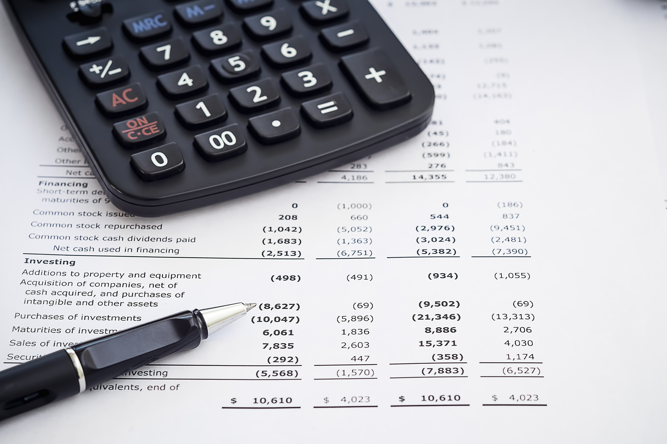




Financial Awareness
Benefits &
Impact
User-Friendly Interface
Understand spending habits.
Simple & easy-to-use
Savings Growth
Automation
Encourages better financial planning
Reduces manual calculations

Slide 7

User Registration & Login
Users sign up or log in via email, phone, or third-party authentication.
Secure authentication ensures data privacy.
01
Income & Expense Management
Users log income and expenses, categorizing transactions.
Automated tracking.
SYSTEM WORKFLOW
02
Budgeting & Smart Alerts
Users set budgets and savings goals.
System sends real-time alerts for overspending or bill reminders.
03
04
Reports & Insights Generation
Generates financial reports, trends, and insights.
Users can export reports in Excel, CSV, or PDF.

Slide 8

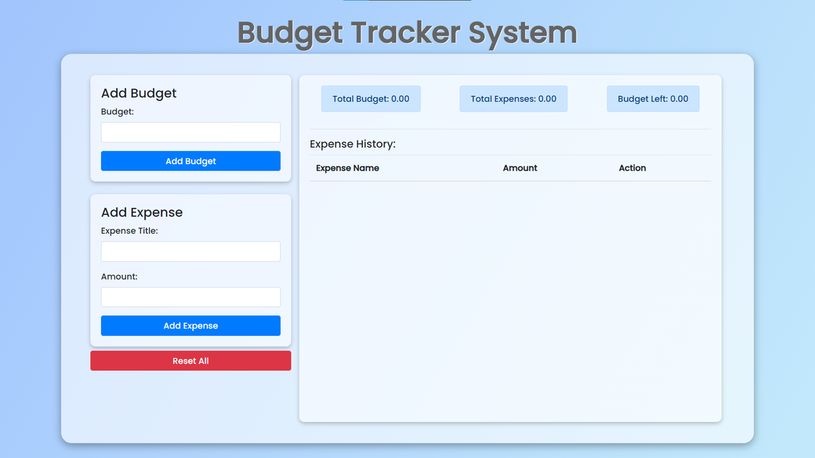
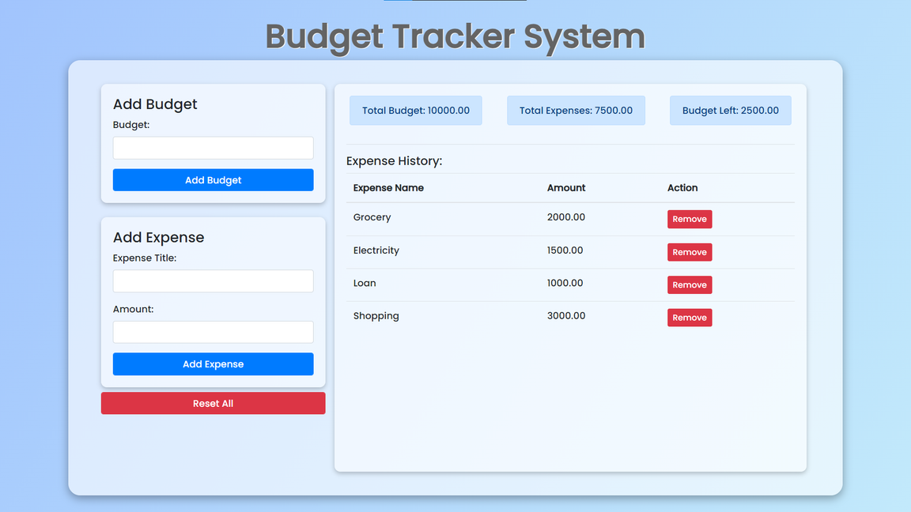
SYSTEM WORKFLOW

Slide 9



Future Scope of Finance Budget Tracker
Real-time Synchronization with Banks and Digital Wallets
Cross-Platform Accessibility and Automation
Integration with AI for Smart Insights
Future budget trackers can leverage artificial intelligence to analyze spending habits, provide personalized financial advice, and predict future expenses.
With increasing digitization, budget trackers can offer seamless integration with multiple financial institutions for real-time updates and consolidated views.
Enhanced compatibility across mobile, desktop, and web platforms with features like voice input, automated bill payments, and smart alerts will make budgeting more convenient and efficient.

Slide 10


CONCLUSION
THE FINANCE BUDGET TRACKER IS A POWERFUL TOOL DESIGNED TO HELP USERS MANAGE THEIR INCOME, EXPENSES, AND SAVINGS EFFICIENTLY. BY PROVIDING REAL-TIME INSIGHTS, AUTOMATED TRACKING, AND SMART BUDGETING, IT ENABLES USERS TO MAKE INFORMED FINANCIAL DECISIONS AND ACHIEVE THEIR FINANCIAL GOALS.

Slide 11




MoneyMap Creators
Aditya Sharma
Vikas SIngh
Akash
Deepanshu Rana
Frontend Developer
Backend Developer
Data Manager
Tester

Slide 12


MoneyMap
Track, Save, Grow
Smart Budgeting for a Smarter Future
THANK YOU!
By: Aditya (22/FCA/BCA/058)
Vikas (22/FCA/BCA/1O5)
Akash (22/FCA/BCA/059)
Deepanshu (22/FCA/BCA/068)

